Slide 1
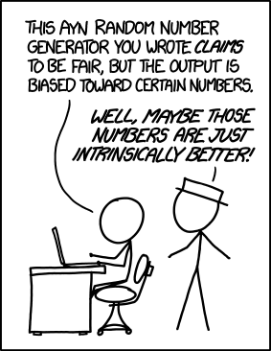
PC: https://xkcd.com/1277

Slide 2
Bias
Eric Wong
9/1/2022

Slide 3
Announcements
Ed Discussion is up
Sign up for paper presentations
Materials from first lecture are posted

Slide 4
Paper presentations
Readings posted by the end of Friday for next week (suggestions welcome)
Presenters: prepare notes to lead seminar
Everyone else: post in Ed Discussion before class

Slide 5
What is bias?
“A tendency for or against something”

Slide 6
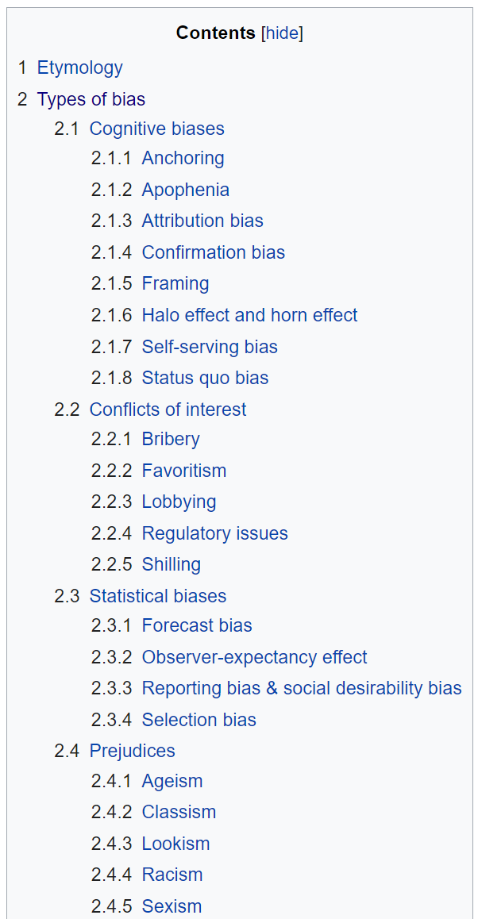
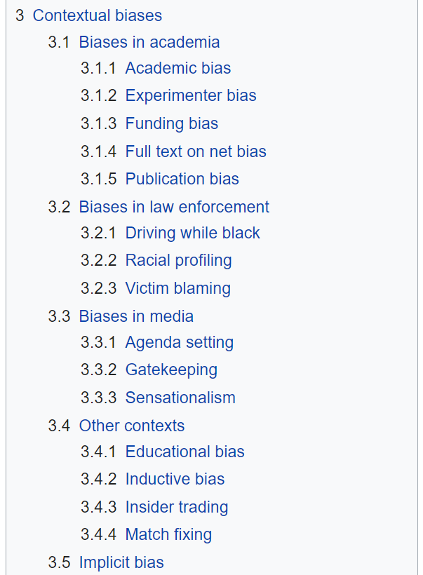
Wikipedia

Slide 7
Types of bias
Statistical bias (board)
Learning bias (board)
Data bias (these slides)

Slide 8
Harms of representation
Stereotyping
Recognition
Denigration
Under representation

Slide 9
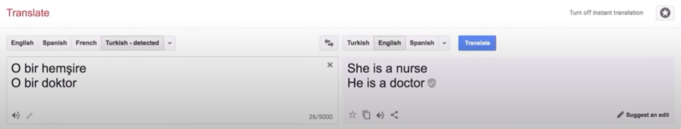
1. Stereotyping
PC: Kate Crawford, “The Trouble with Bias” NeurIPS 2017 keynote

Slide 10
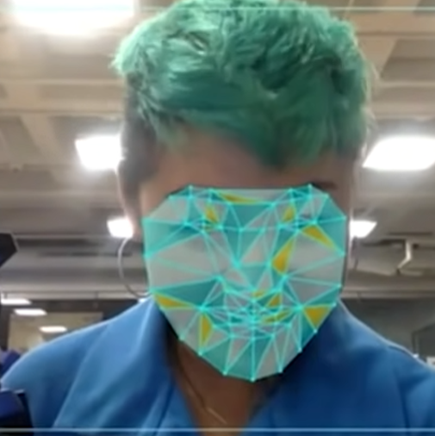
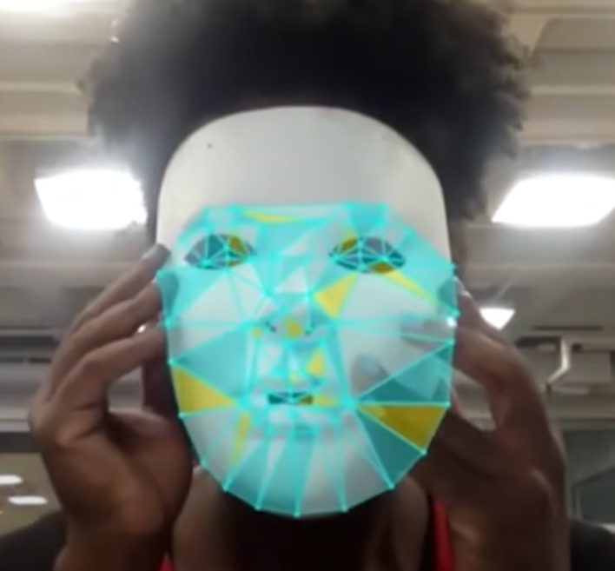
2. Recognition
Buolamwini & Gebru, “Gender Shaes: Intersectional Accuracy Disparities in Commercial Gender Classification”

Slide 11
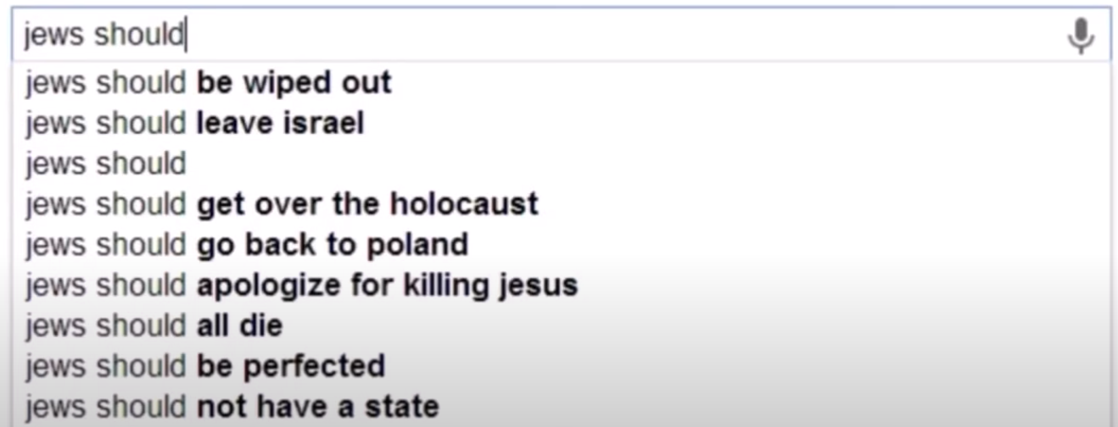
3. Denigration
PC: Kate Crawford, “The Trouble with Bias” NeurIPS 2017 keynote

Slide 12
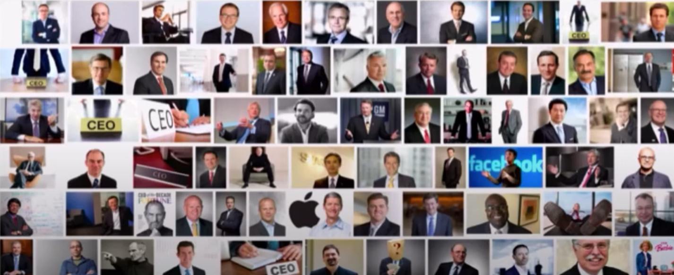
4. Under representation
Kay et al. 2015, “Unequal Representation and Gender Stereotypes in Image Search Results for Occupations”
PC: Kate Crawford, “The Trouble with Bias” NeurIPS 2017 keynote

Slide 13
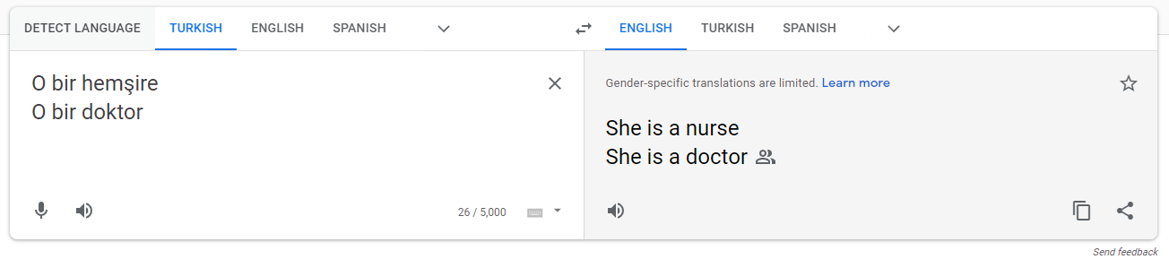
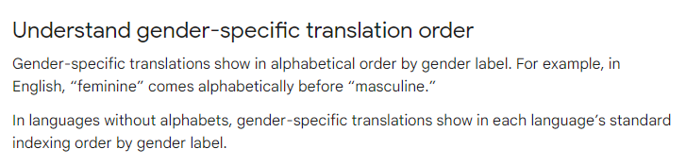

Slide 14
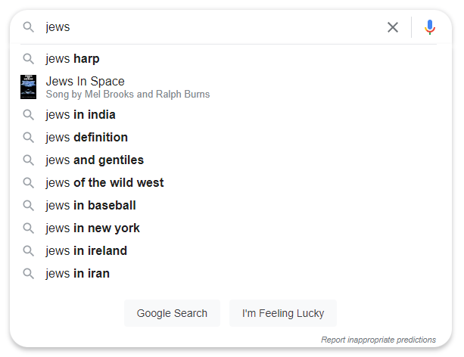
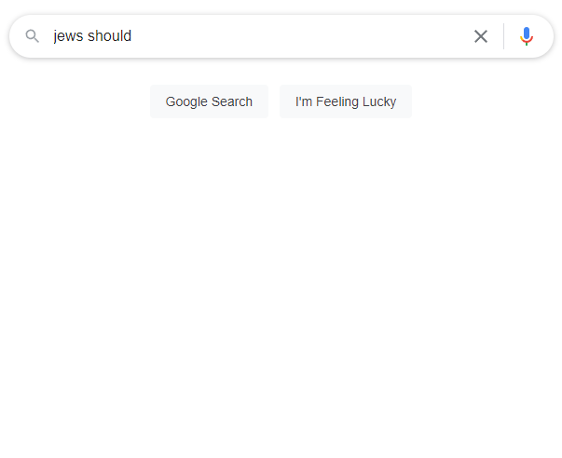
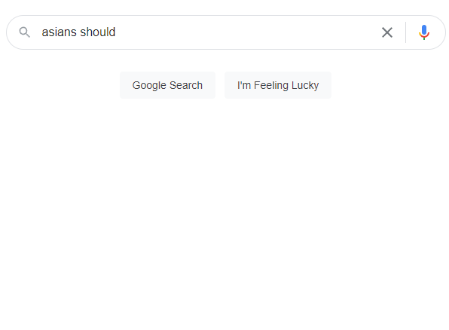
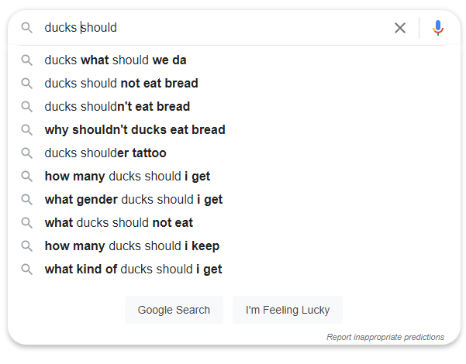

Slide 15
